Slide 1
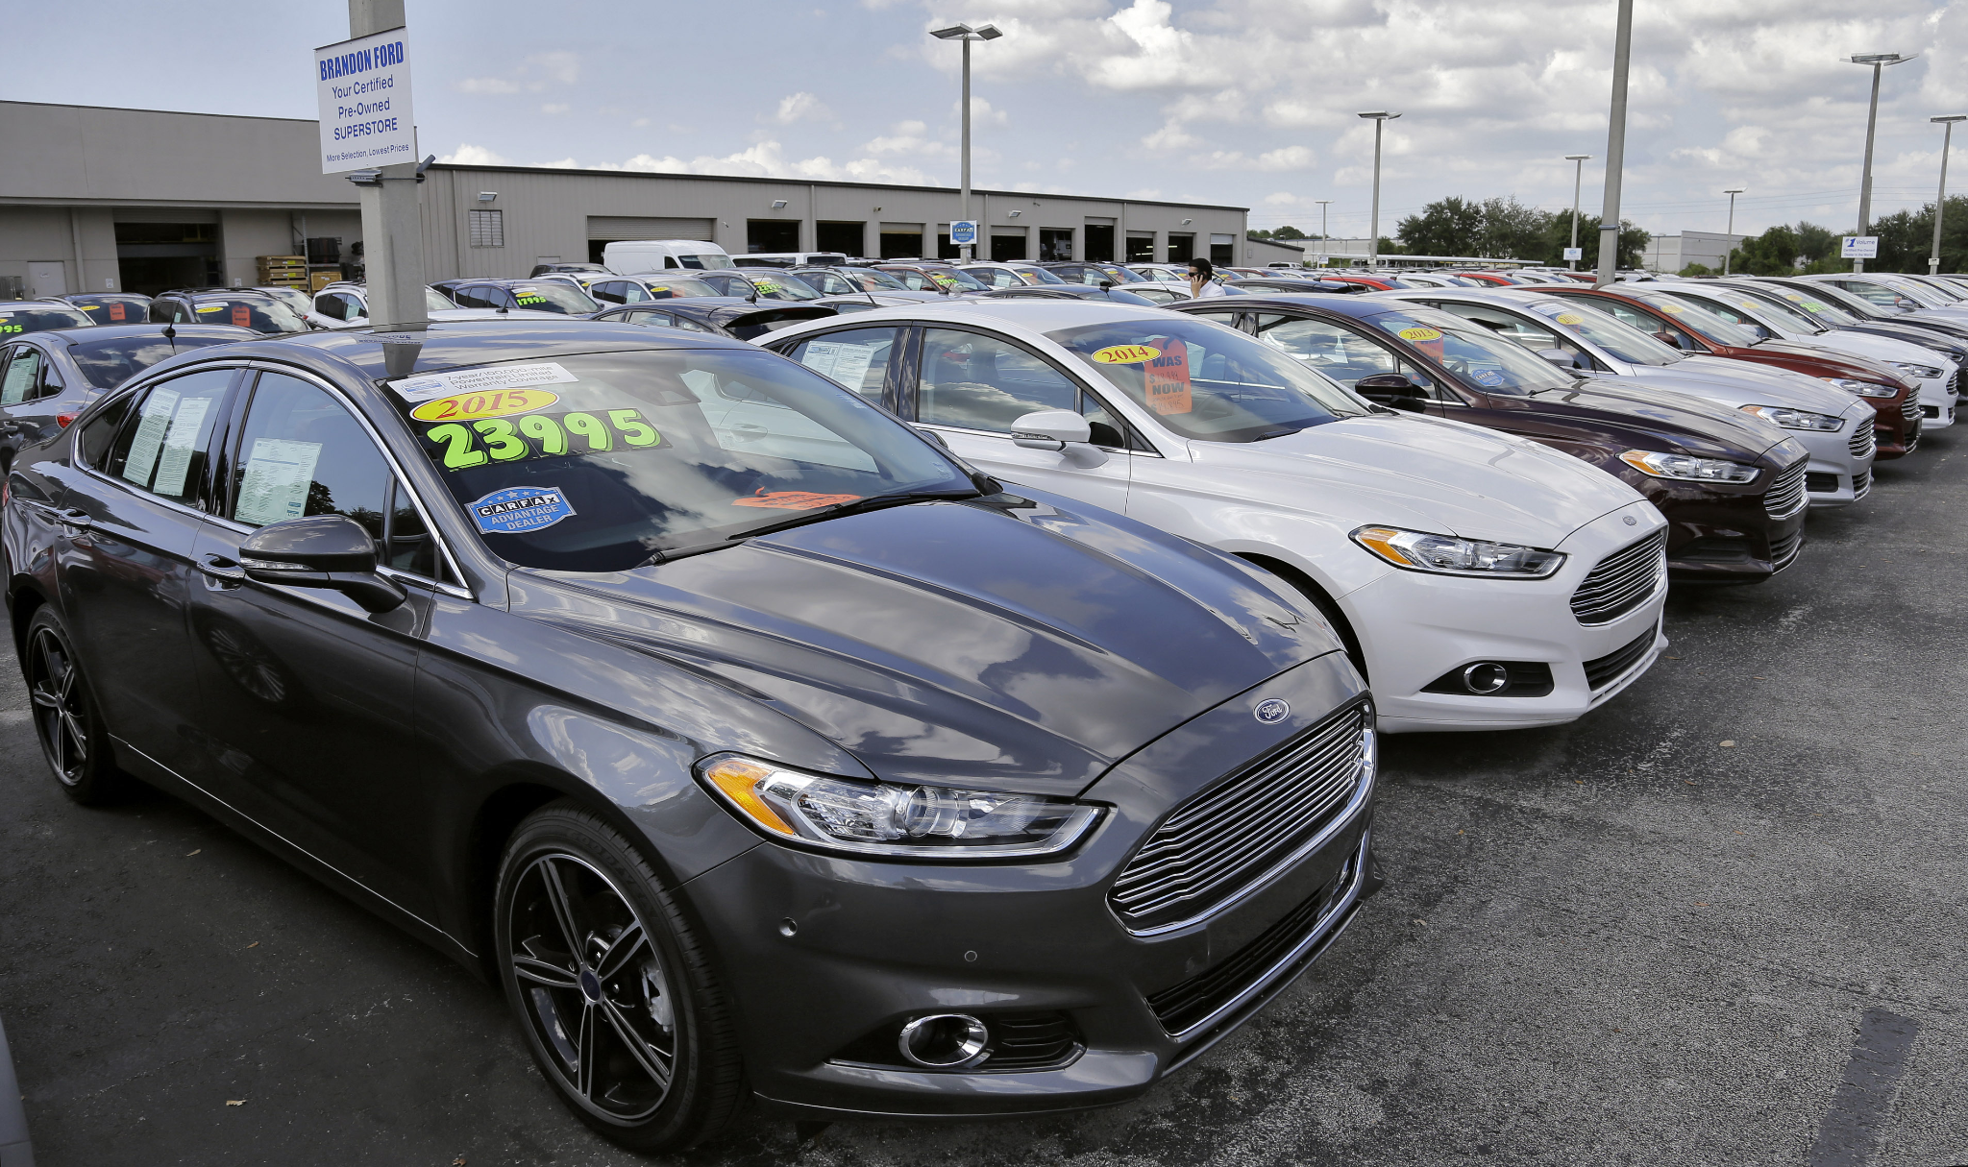
Cars4U &
Used Cars Price Prediction
By Luca Scutari

Slide 2
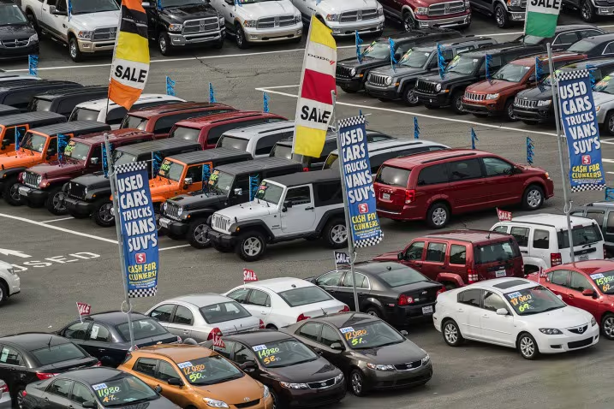
Problem
Definition
And why is it a problem?

Slide 3

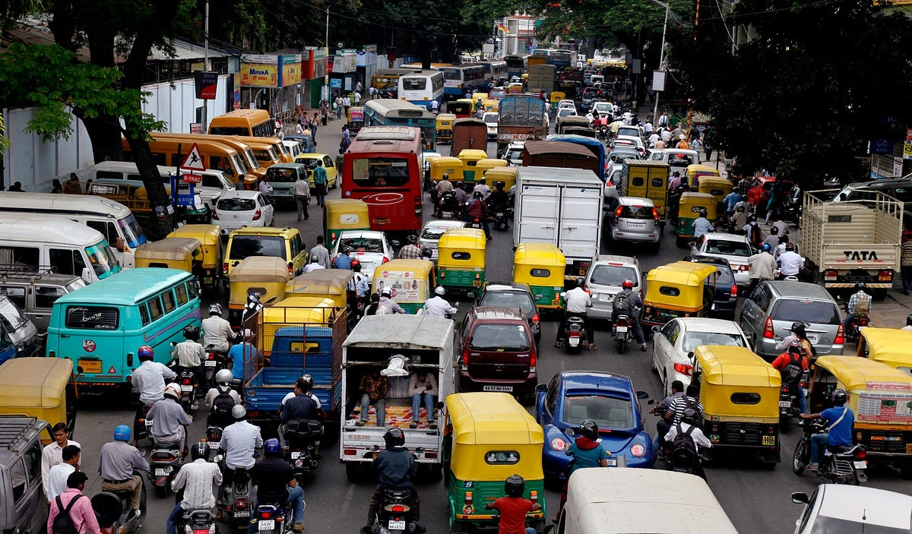
What is the Problem?
There is a huge demand increase for used cars in the Indian Market
Tech start-up Cars4U wants to enter the Indian Used Cars Market
There is a need for ensuring that the data of the pre-owned car market is accurate to make it easier and potentially cheaper to purchase cars

Slide 4
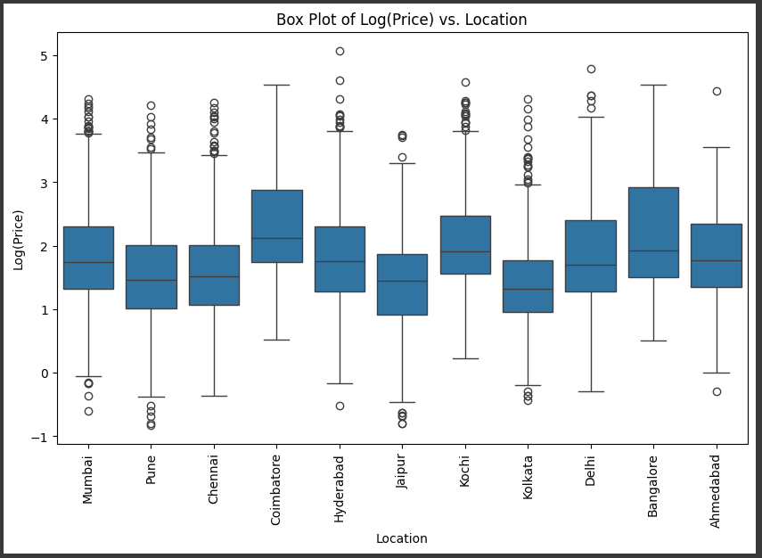
The Solution
Make use of Machine Learning to create a regression model to predict prices of future vehicles added to the market
Data Exploration led to:
There is a lot of incorrect data in the market
Location actively changes the price of all cars

Slide 5
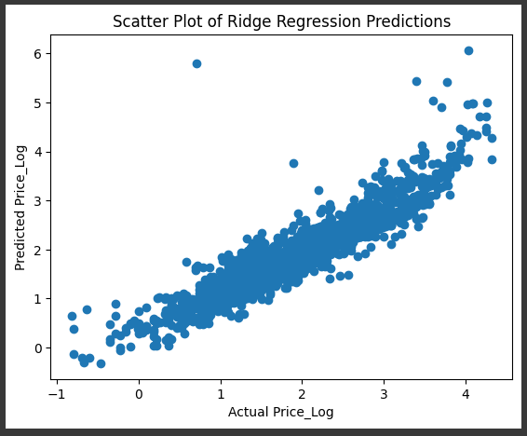
What is the Proposed Model?

Slide 6
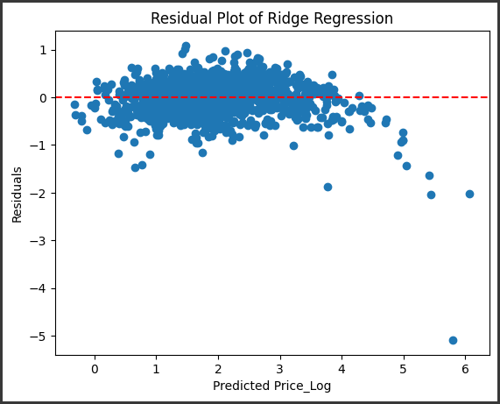
The Ridge Model
Ridge Recession had good accuracy while executing way quicker than others with similar accuracy
The Actual Price and the Predicted Price of the cars were extremely similar across the board

Slide 7
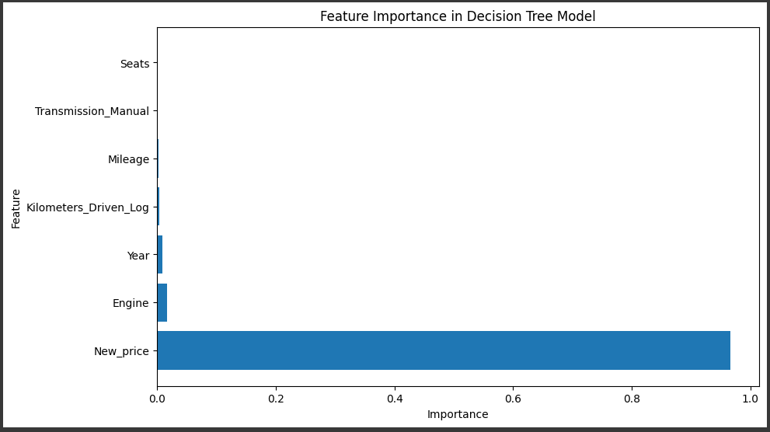
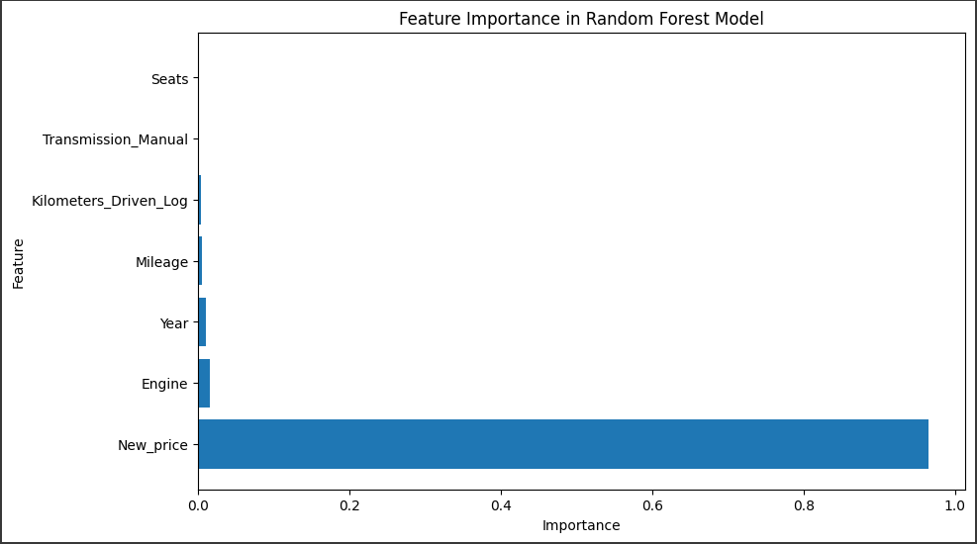
Other Models?
Linear:
Least accurate
Decision Trees:
Not enough valuable conclusions
Random Forest:
Most resource intensive

Slide 8
Proposed Business Solution
Local, smaller scale launches of the Ridge Regression Model
Use a “window” of data: start by limiting it to cars in the same city, expand if necessary to cars of the same Engine, then Year, etc.
Once the business is going, research into other Machine Learning models for possible business improvements
Once Cars4U grows, then using models like Random Forest could be used for better accuracy

Slide 9
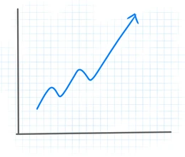
Why this Business Solution
More small models instead of 1 large one
Makes adjusting for local events easier
Less need for intensive hardware
This approach allows for either:
A large, centralized server
A network of local servers
Done through Cloud

Slide 10
Executive Summary
By focusing on local pricing, Cars4U can guarantee higher degree of accuracy while decreasing run time
Focusing on the cars pricing if it was new is the easiest and most reliable way to ensure that the price is assigned correctly
Once the business launches and grows, further research into potential improvements on the Machine Learning model can be done
The longer we wait, the harder it will be to replace this core process

Slide 11
Risks &
Challenges
Car does not have enough points of reference locally
Increase the “Window” of data
Cars with new technology or new Models/Brands can be hard to predict
Example: Tesla Model 3
Consistent retraining!
Having multiple, local models means that some cars might sell less if bought in certain cities
Worth considering in the future for the company if it is better to increase the price and pay for transportation to the city of the buyer
And what can we do about them?

Slide 12
Thank you!

